Slide 1
Content-Aware Image Resizing

Slide 2
Introduction
Image resizing
1

Slide 3
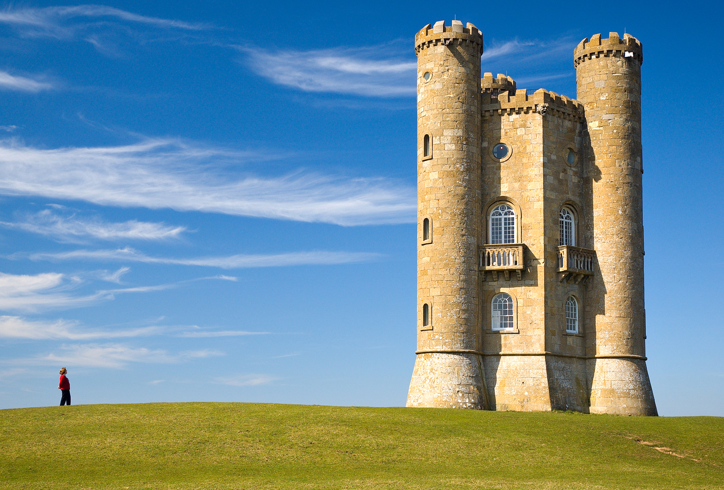
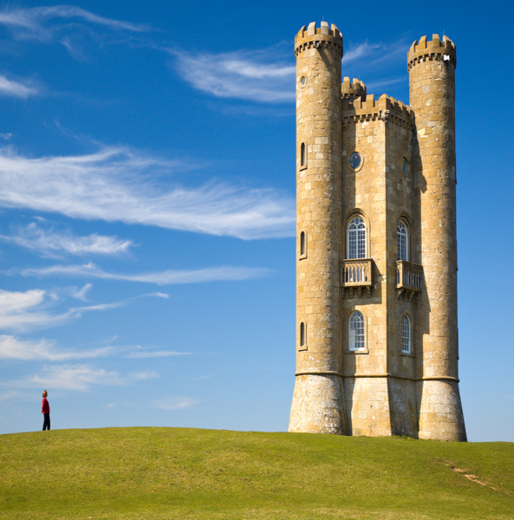
Image Resizing
Reducing/Extending image height and width
Can be done by scaling, cropping
Height
Width

Slide 4
Image Scaling
No part of image is removed
Problem: size of object (catsle) is distorted
Height
Width

Slide 5
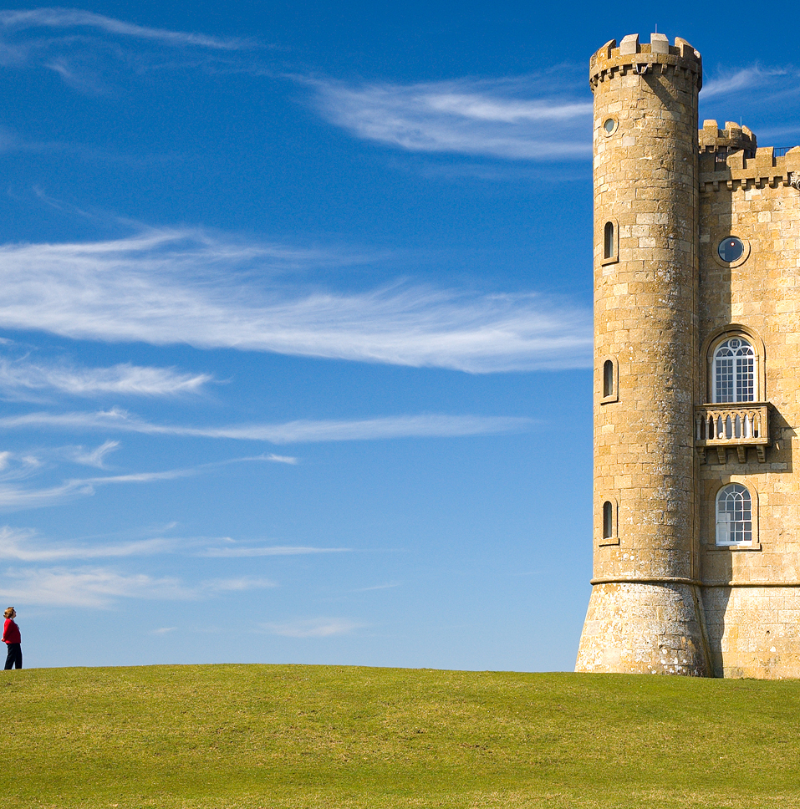
Image Cropping
Size of object is not distorted
Problem: part of object (castle) is removed
Height
Width

Slide 6
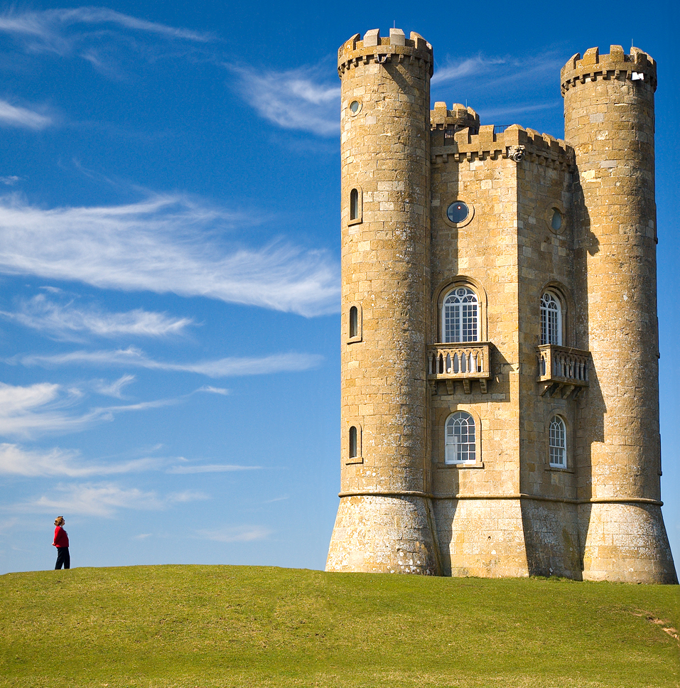
Content-Aware Image Resizing
Size of object is not distorted
Part of object (castle) is not removed
Height
Width

Slide 7
Content-Aware Image Resizing

Slide 8
Algorithm
Seam Carving
2

Slide 9
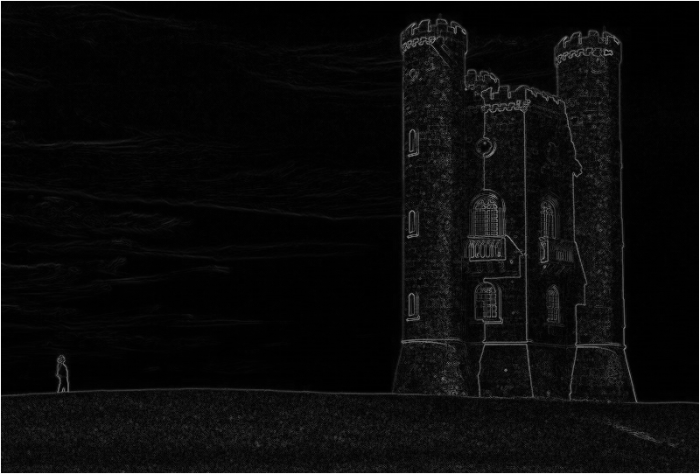
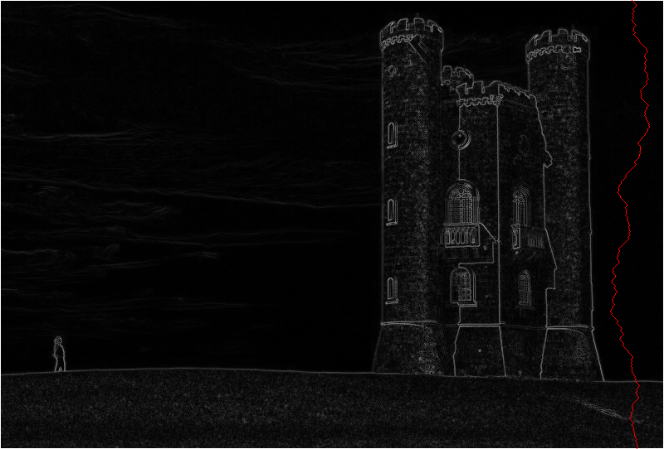
Algorithm (Seam Carving)
Computing energy of pixels
Find vertical/horizontal seams
Remove the seams from image
Compute energy
Find seam
Remove seam
Repeat N times

Slide 10
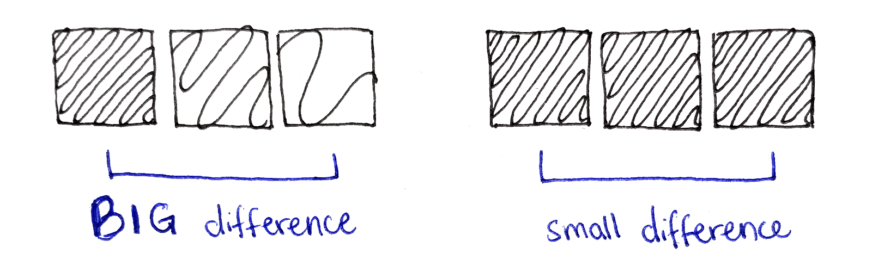
Compute energy
Energy of a pixel measures its contrast with its neighbor pixels.
High energy
Low energy

Slide 11
Compute energy
White pixel -> High energy
Black pixel -> Low energy

Slide 12
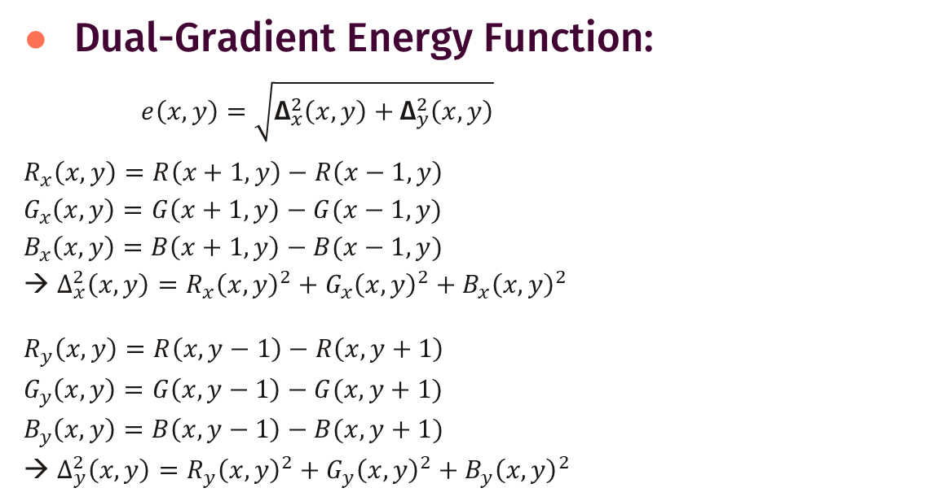
Compute energy
x - coordinate
Dual-Gradient Energy Function:
$e\left(x,y\right)=\sqrt{{\text{Δ}}_{x}^{2}\left(x, y\right)+{\text{Δ}}_{y}^{2}\left(x,y\right)}$
$$R_{x}\left(x, y\right)=R\left(x+1,y\right)−R\left(x−1, y\right)$$
$$G_{x}\left(x, y\right)=G\left(x+1,y\right)−G(x−1, y)$$
$$B_{x}\left(x, y\right)=B\left(x+1,y\right)−B(x−1, y)$$
→ $Δ_{x}^{2}\left(x,y\right)=R_{x}{\left(x,y\right)}^{2}+G_{x}{\left(x,y\right)}^{2}+B_{x}{\left(x,y\right)}^{2}$
$$R_{y}\left(x, y\right)=R\left(x,y−1\right)−R\left(x, y+1\right)$$
$$G_{y}\left(x, y\right)=G\left(x,y−1\right)−G(x, y+1)$$
$$B_{y}\left(x, y\right)=B\left(x,y−1\right)−B(x, y+1)$$
→ $Δ_{y}^{2}\left(x,y\right)=R_{y}{\left(x,y\right)}^{2}+G_{y}{\left(x,y\right)}^{2}+B_{y}{\left(x,y\right)}^{2}$
y - coordinate
x-1, y-1 | x, y-1 | x+1, y-1
x-1, y | x, y | x+1, y
x-1, y+1 | x, y+1 | x+1, y+1

Slide 13
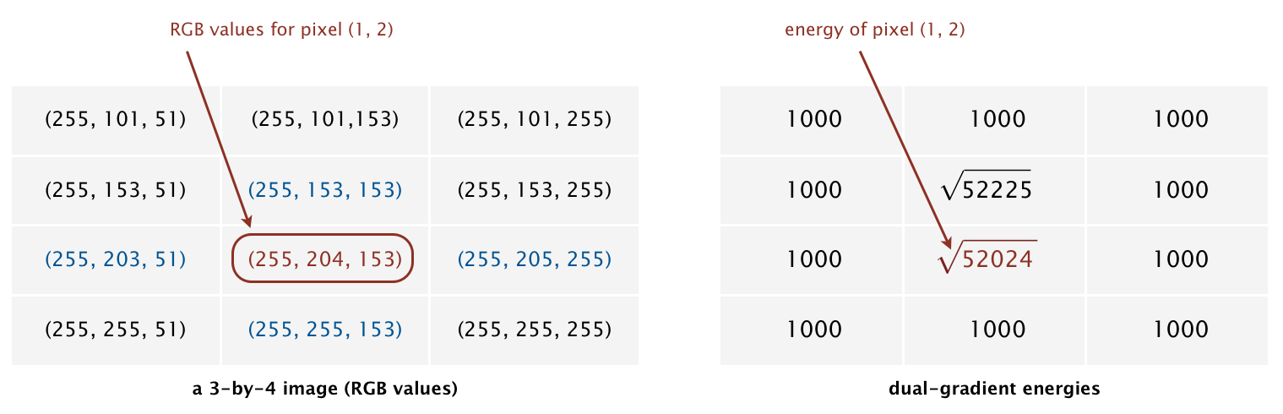
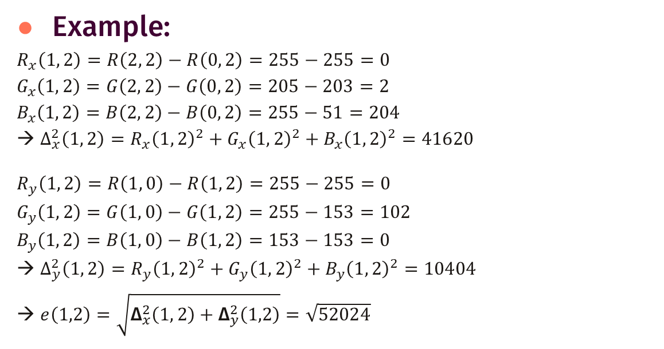
Compute energy
x
O
Example:
$$R_{x}\left(1, 2\right)=R\left(2, 2\right)−R\left(0, 2\right)=255−255=0$$
$$G_{x}\left(1, 2\right)=G\left(2, 2\right)−G\left(0, 2\right)=205−203=2$$
$$B_{x}\left(1, 2\right)=B\left(2, 2\right)−B\left(0, 2\right)=255−51=204$$
→ $Δ_{x}^{2}\left(1, 2\right)=R_{x}{\left(1, 2\right)}^{2}+G_{x}{\left(1, 2\right)}^{2}+B_{x}{\left(1, 2\right)}^{2}=41620$
$$R_{y}\left(1, 2\right)=R\left(1, 0\right)−R\left(1, 2\right)=255−255=0$$
$$G_{y}\left(1, 2\right)=G\left(1, 0\right)−G\left(1, 2\right)=255−153=102$$
$$B_{y}\left(1, 2\right)=B\left(1, 0\right)−B\left(1, 2\right)=153−153=0$$
→ $Δ_{y}^{2}\left(1, 2\right)=R_{y}{\left(1, 2\right)}^{2}+G_{y}{\left(1, 2\right)}^{2}+B_{y}{\left(1, 2\right)}^{2}=10404$
→ $e\left(1,2\right)=\sqrt{{\text{Δ}}_{x}^{2}\left(1, 2\right)+{\text{Δ}}_{y}^{2}\left(1,2\right)}=\sqrt{52024}$
y

Slide 14
Compute energy
Note:
Pixels in the border of image must have maximum value to avoid being removed from image

Slide 15
Find Vertical/Horizontal Seam
Seam: sequence of pixels forming a path
Vertical seam: top -> bottom
Horizontal seam: left -> right

Slide 16
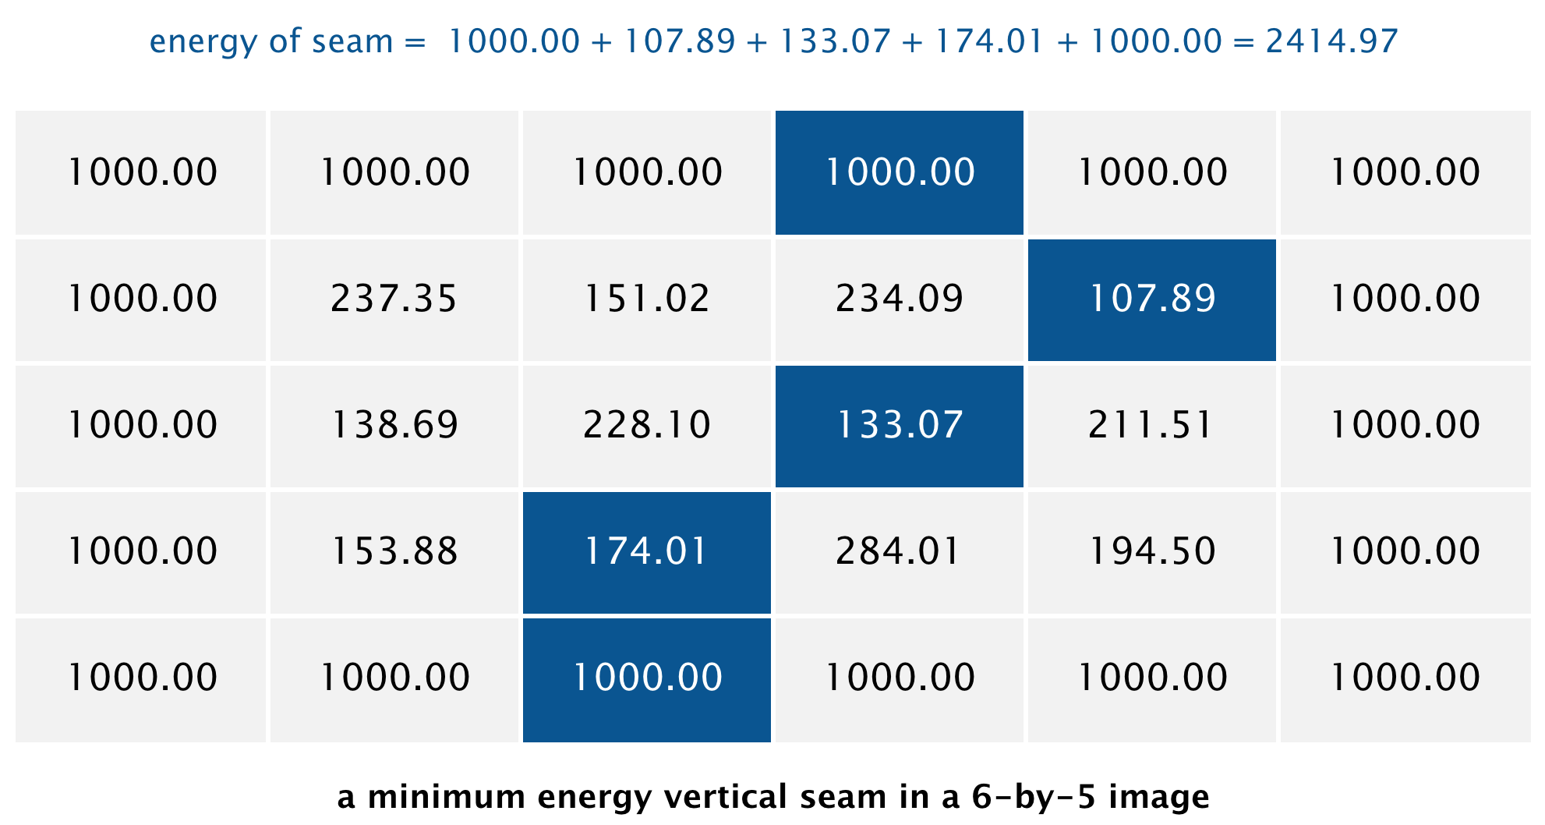
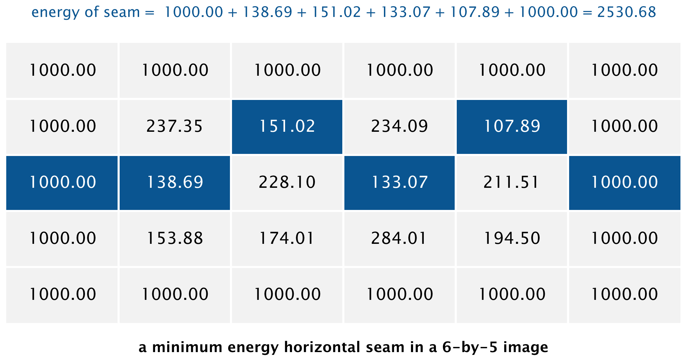
Find Vertical/Horizontal Seam
Lowest-energy seam: path of minimum energy cost from one end of image to another
Can be solved using dynamic programming

Slide 17
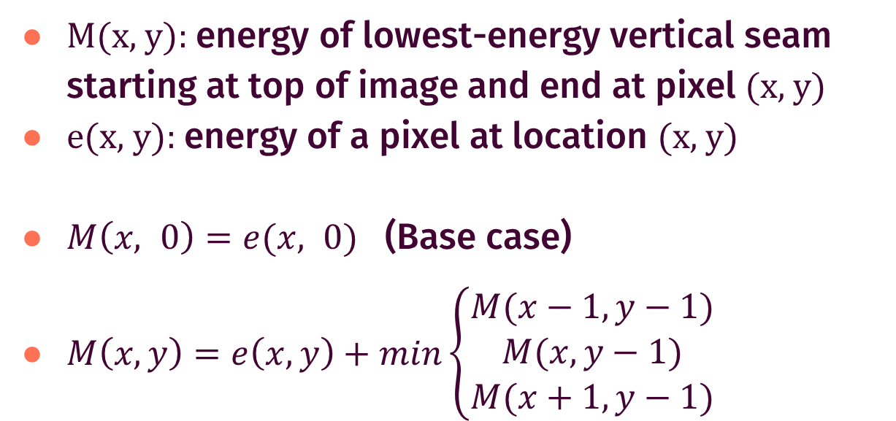
Dynamic programming (Vertical)
M(x, y): energy of lowest-energy vertical seam starting at top of image and end at pixel (x, y)
e(x, y): energy of a pixel at location (x, y)
$M\left(x, 0\right)=e(x, 0)$ (Base case)
$M\left(x, y\right)=e\left(x,y\right)+min\left\{\begin{aligned}M(x−1, y−1) \\ M(x, y−1) \\ M(x+1, y−1)\end{aligned}\right.$

Slide 18
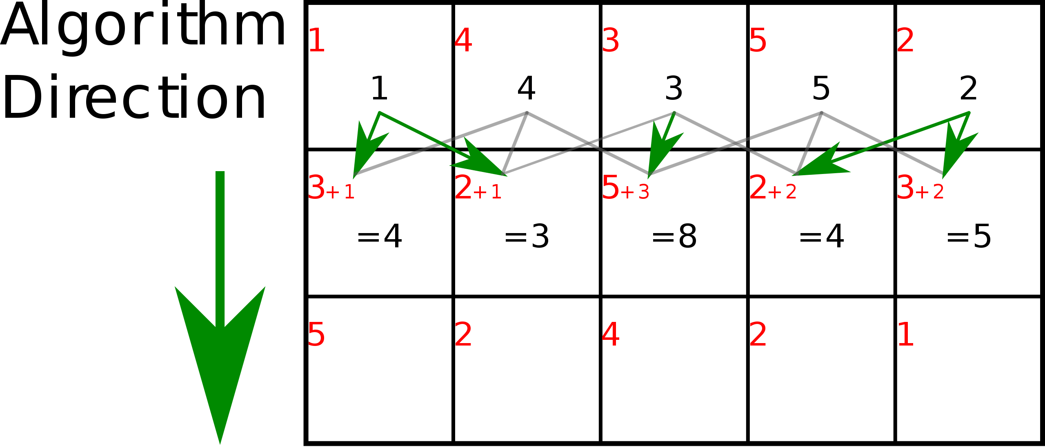
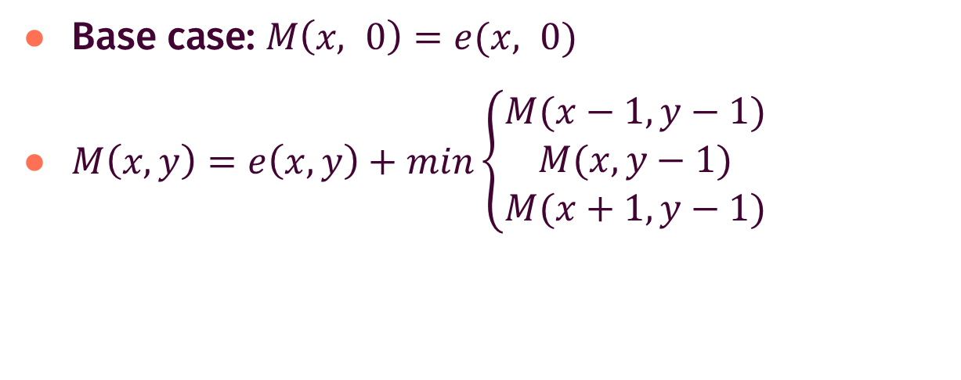
Dynamic programming (Vertical)
$\text{Base} \text{case}\text{: }M\left(x, 0\right)=e(x, 0)$
$M\left(x, y\right)=e\left(x,y\right)+min\left\{\begin{aligned}M(x−1, y−1) \\ M(x, y−1) \\ M(x+1, y−1)\end{aligned}\right.$
Red Value: e(x, y)
Black Value: M(x, y)

Slide 19
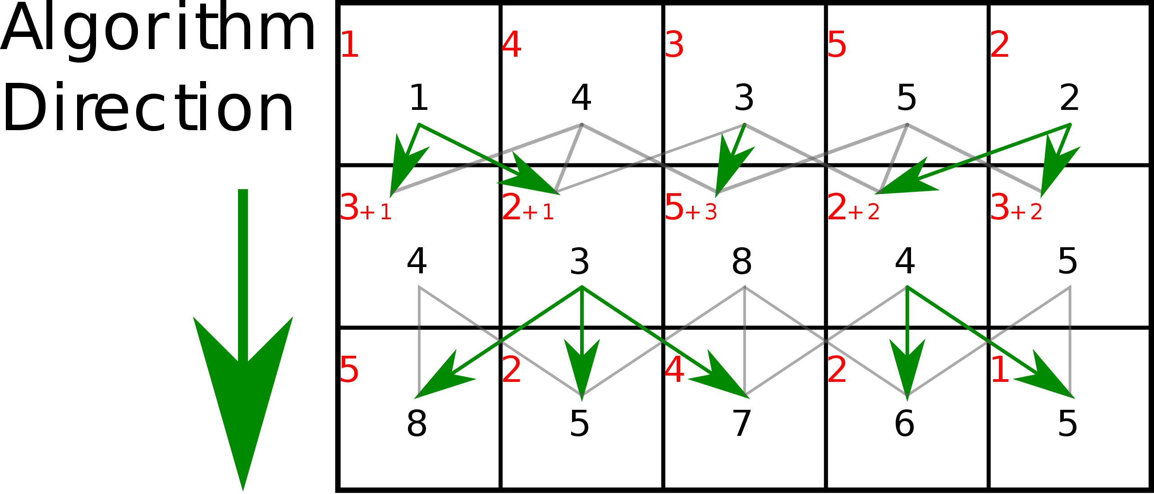
Dynamic programming (Vertical)
$\text{Base} \text{case}\text{: }M\left(x, 0\right)=e(x, 0)$
$M\left(x, y\right)=e\left(x,y\right)+min\left\{\begin{aligned}M(x−1, y−1) \\ M(x, y−1) \\ M(x+1, y−1)\end{aligned}\right.$
Red Value: e(x, y)
Black Value: M(x, y)

Slide 20
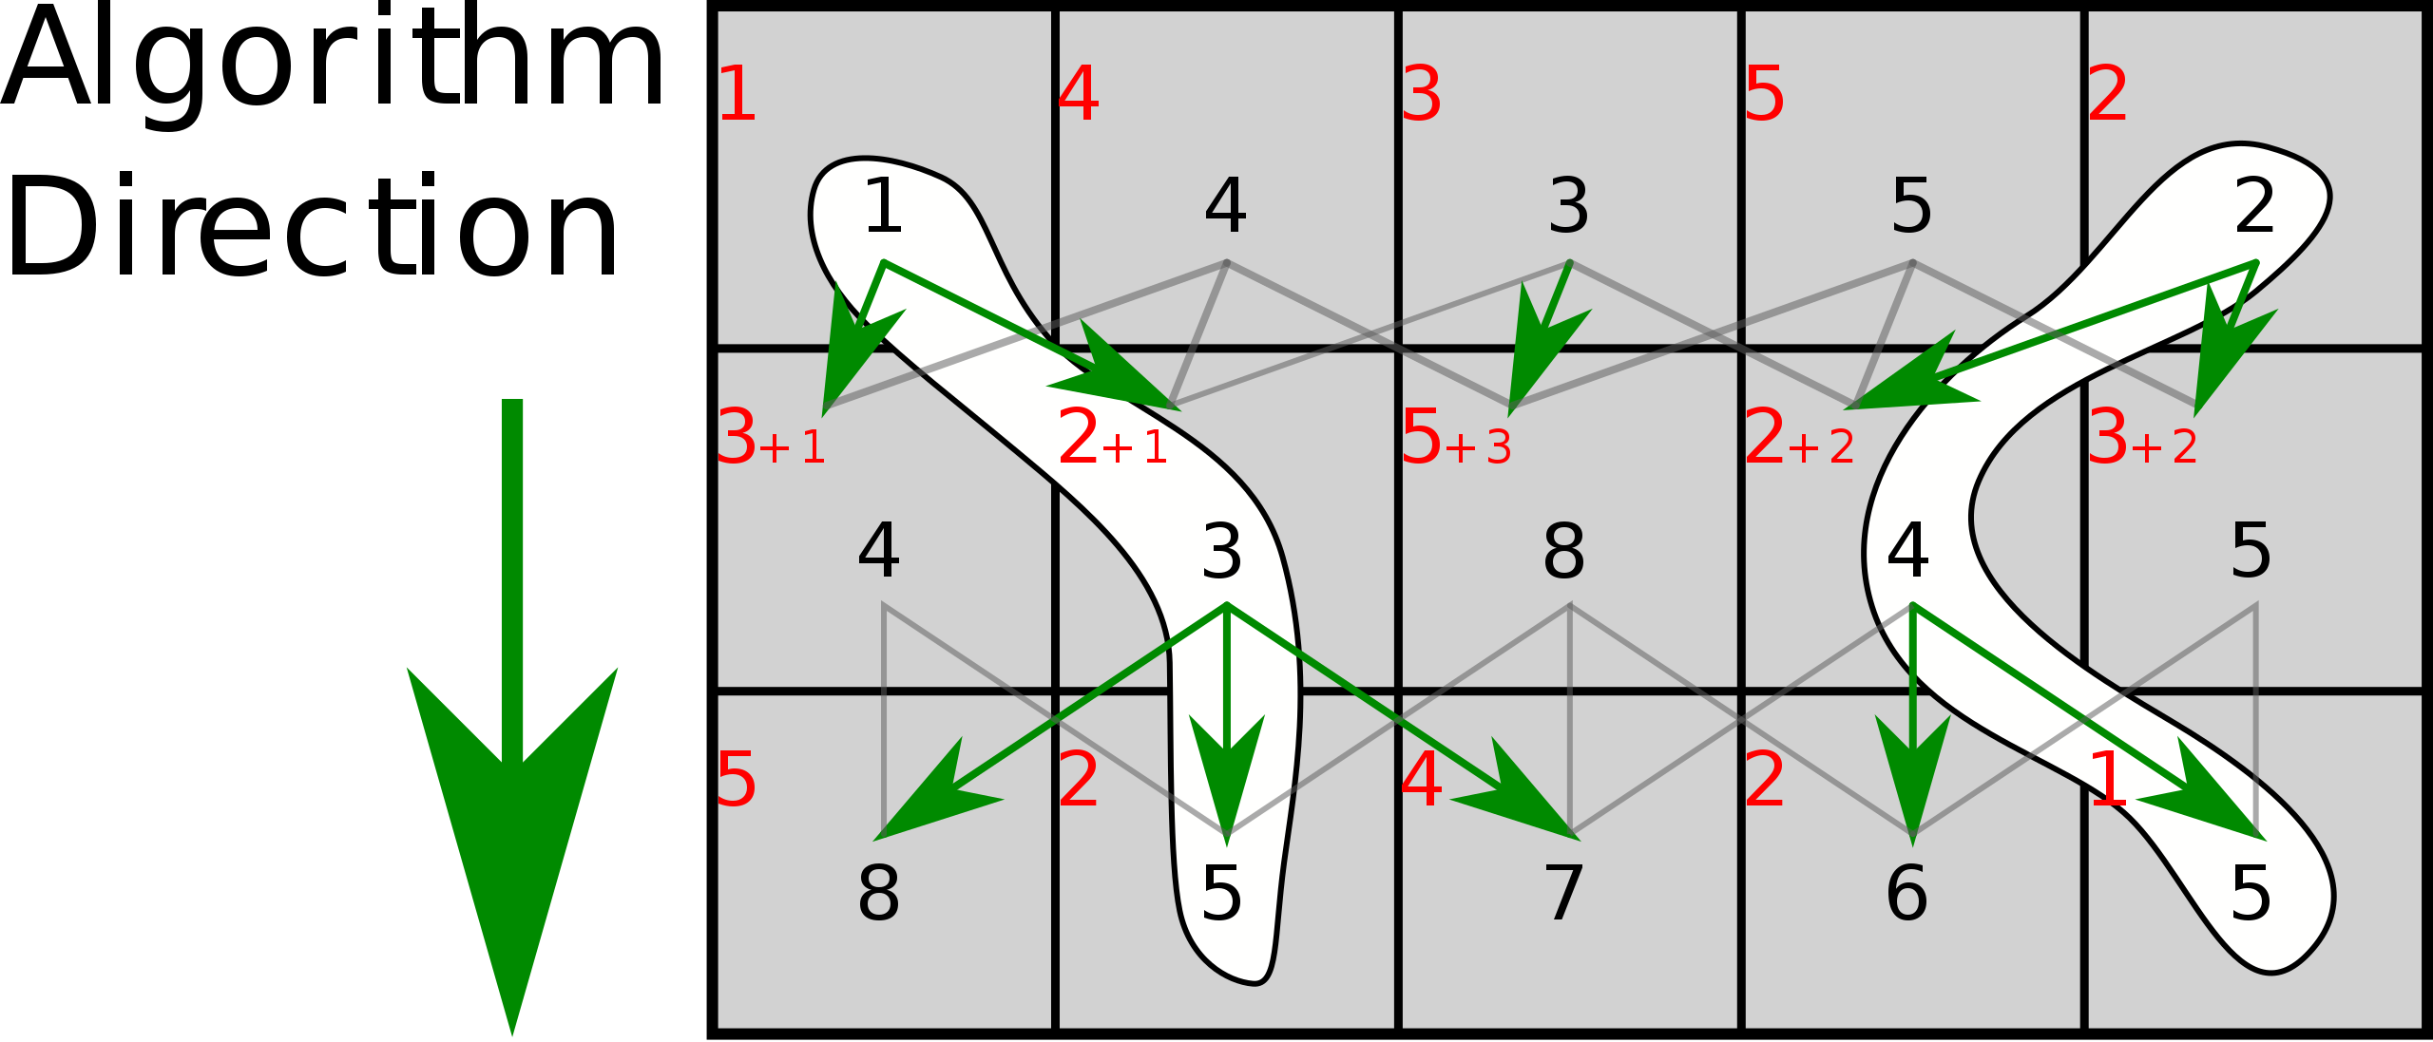
Dynamic programming (Vertical)
Look for the lowest energy at the last row after computing M(x, y)
Work back up to reconstruct the seam with minimal energy
Red Value: e(x, y)
Black Value: M(x, y)

Slide 21
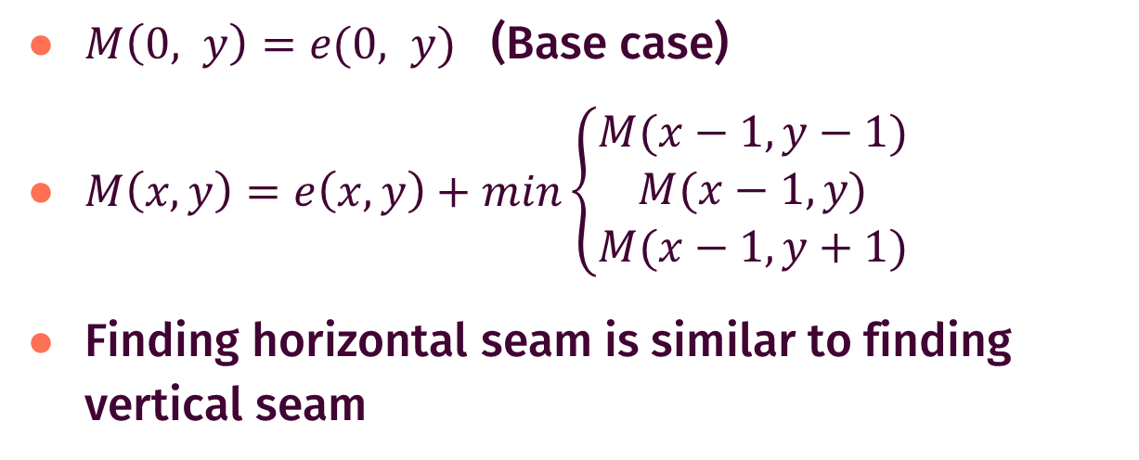
Dynamic programming (Horizontal)
$M\left(0, y\right)=e(0, y)$ (Base case)
$M\left(x, y\right)=e\left(x,y\right)+min\left\{\begin{aligned}M(x−1, y−1) \\ M(x−1, y) \\ M(x−1, y+1)\end{aligned}\right.$
Finding horizontal seam is similar to finding vertical seam

Slide 22
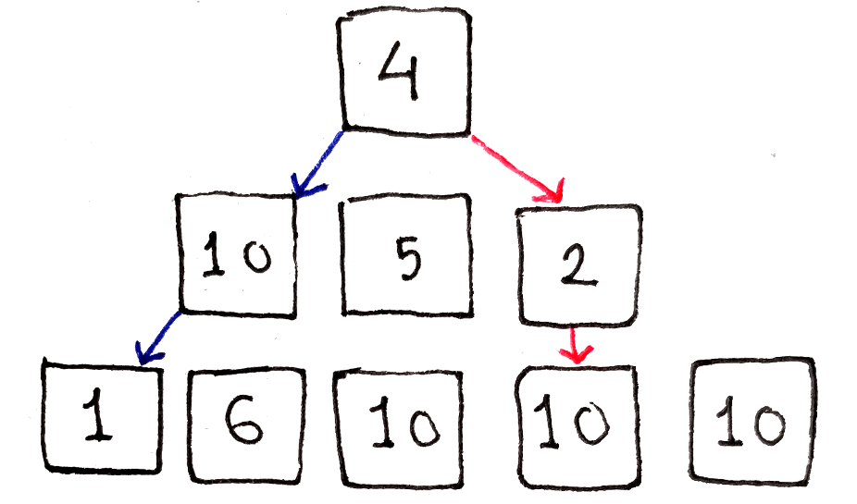
Other approaches
Greedy: starting at top row and picking neighbor pixel with lowest energy in the next row
Problem: can get stuck at a high-energy region of image

Slide 23
Remove seam
Seam is removed by copying the pixels that is not in the seam to a new image with reduced size
Vertical seam: W x H -> (W-1) x H
Horizontal seam: W x H -> W x (H-1)

Slide 24
References
3

Slide 25
References
https://en.wikipedia.org/wiki/Seam_carving
https://avikdas.com/2019/05/14/real-world-dynamic-programming-seam-carving.html
https://coursera.cs.princeton.edu/algs4/assignments/seam/specification.php

Slide 26
Thanks!
Any questions?
Author: TuanTD
Student at FPT University

Slide 27
THE END

